Slide 1

ALL YOU NEED IS…GOOD WINE
3251 - 017.
Group 6: Ali, Neda, Nisarg, Olga, Vaishali, Vinay

Slide 2
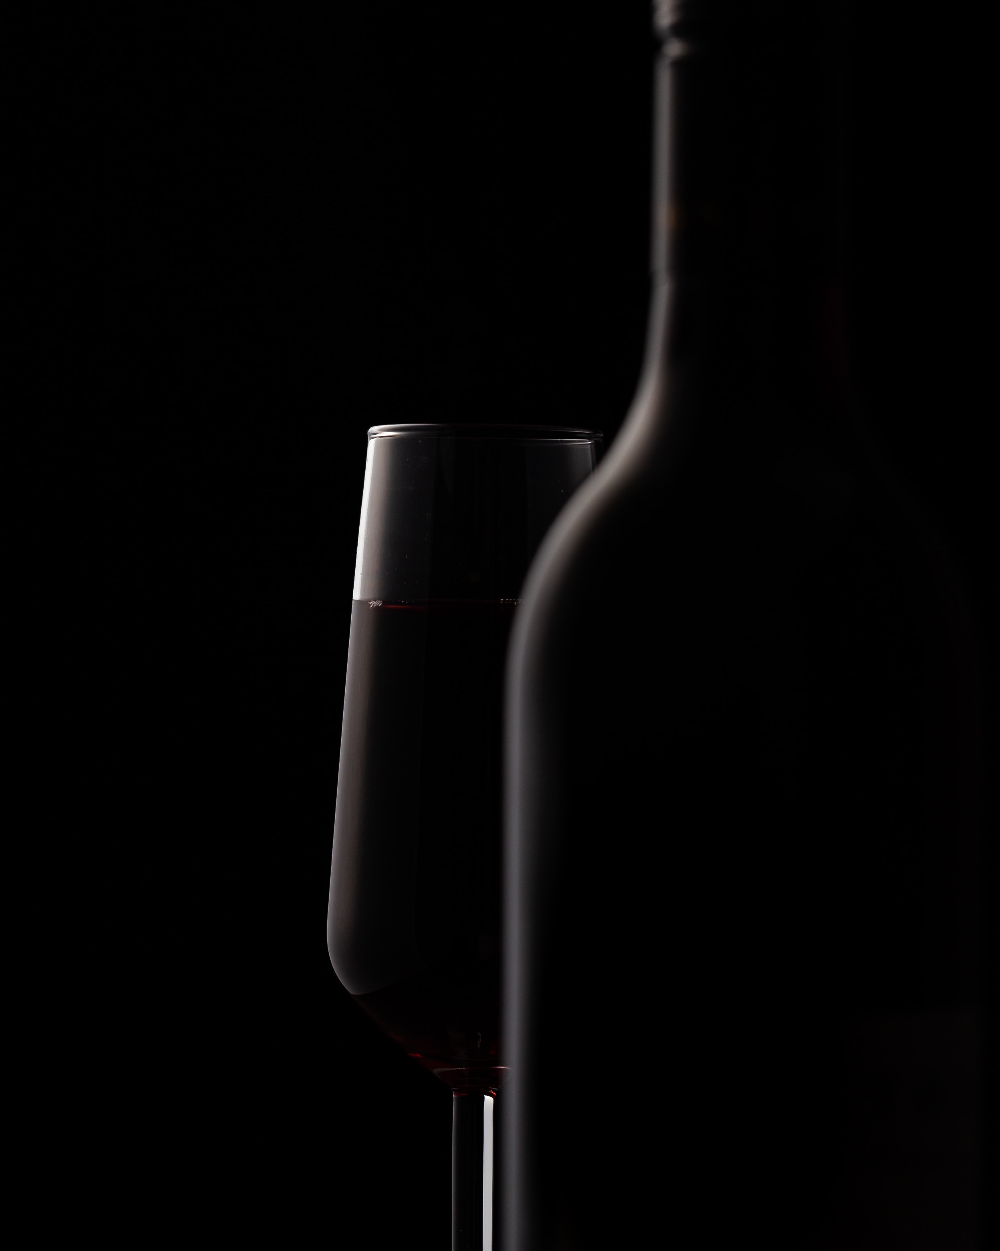
Agenda
Introduction
Hypothesis Testing
Logistic Regression
Linear Regression and SVM
Conclusions

Slide 3
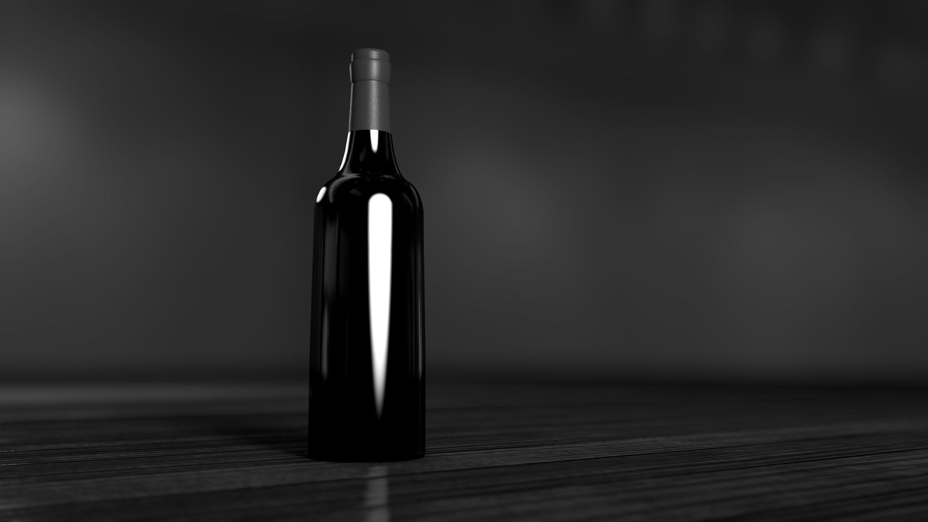
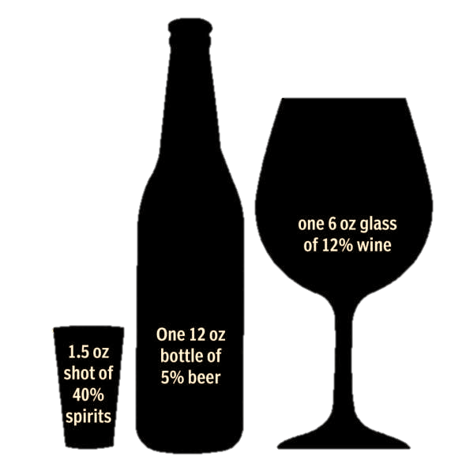
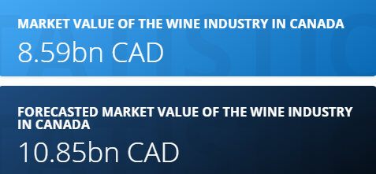
How much do we drink?
What does an average month of drinking look like?
10 Days of consumption per month
13 Unique occasions
25 Total drinks consumed
33%
3.6 liters more than the world average
Across multiple categories (beer, wine, spirits, cider, RTD)
44%
Sources: Statista. Wine market in Canada. World Health Statistics 2016

Slide 4
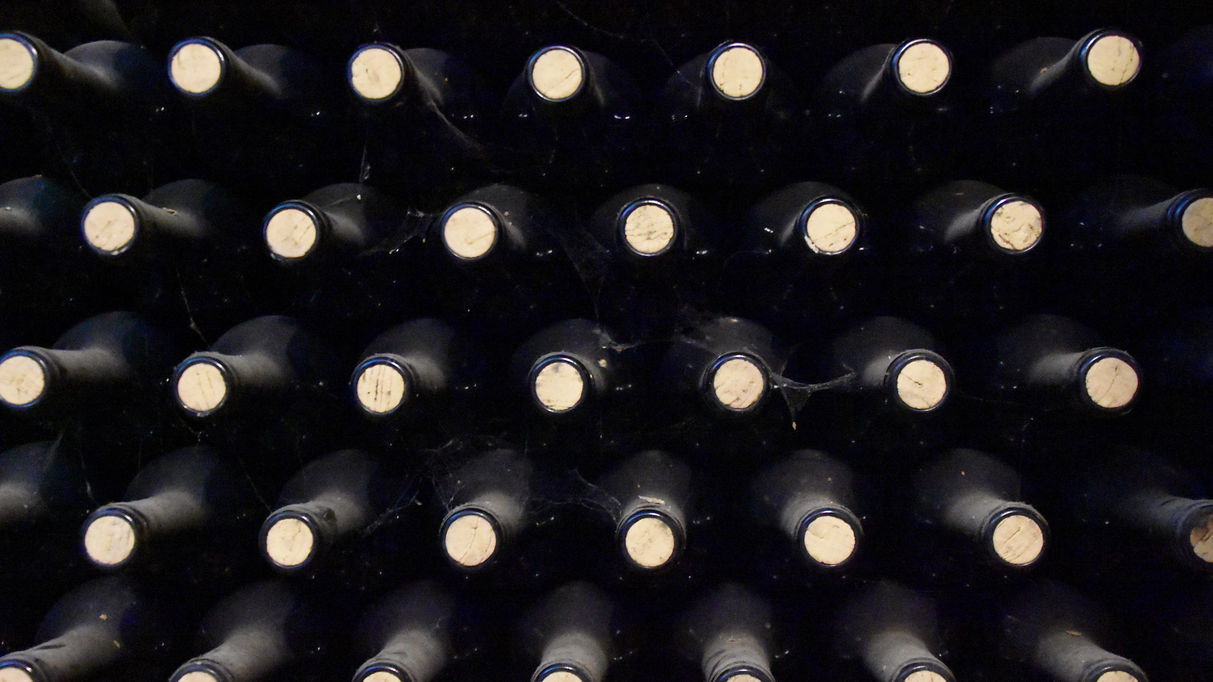
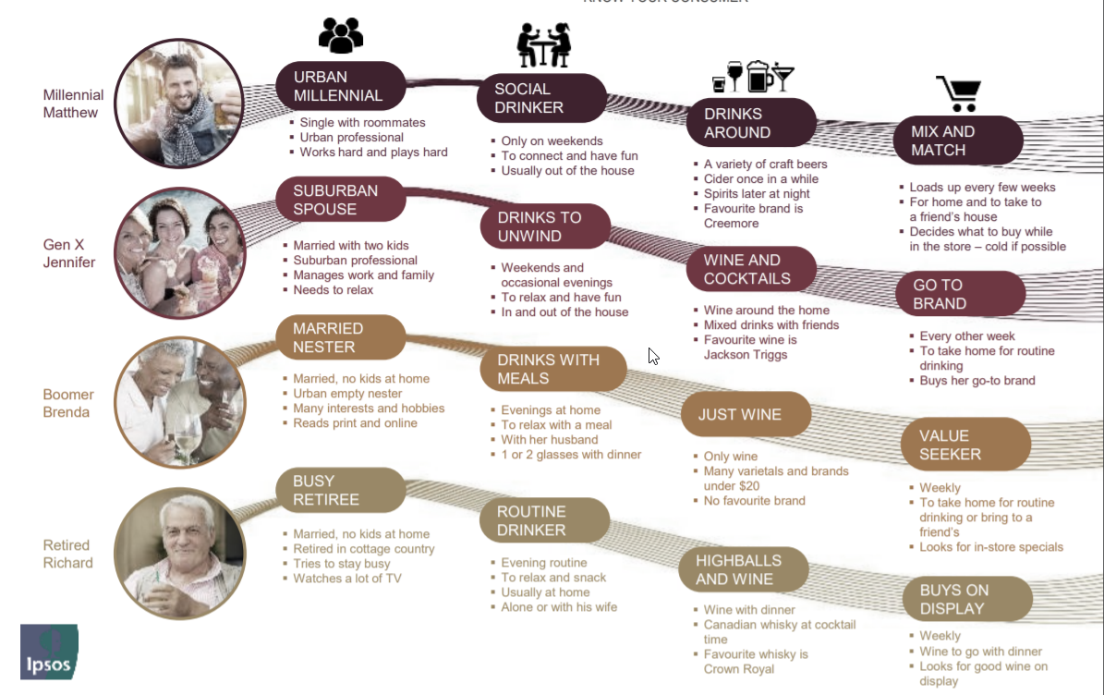
How we drink?

Slide 5
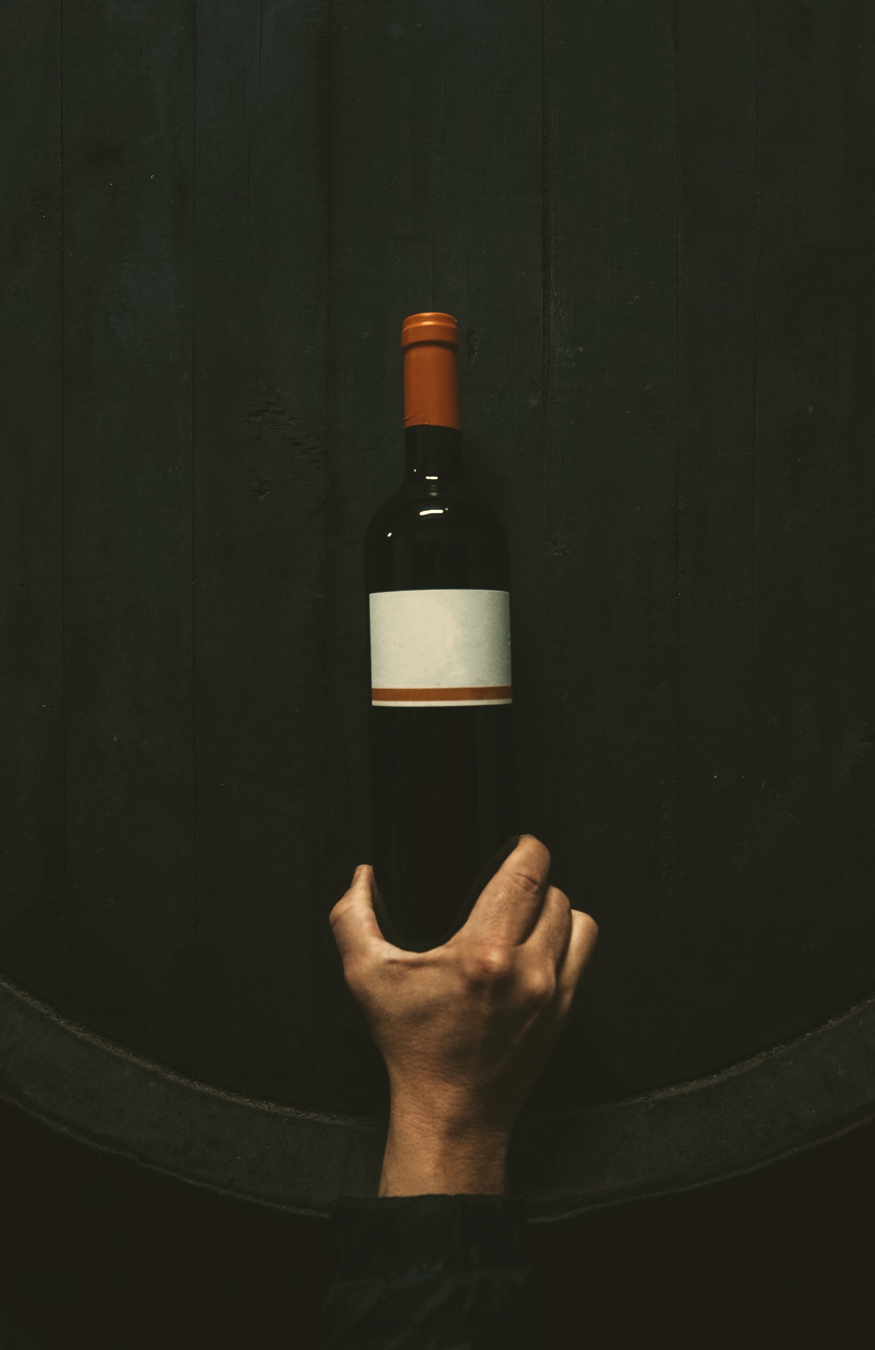
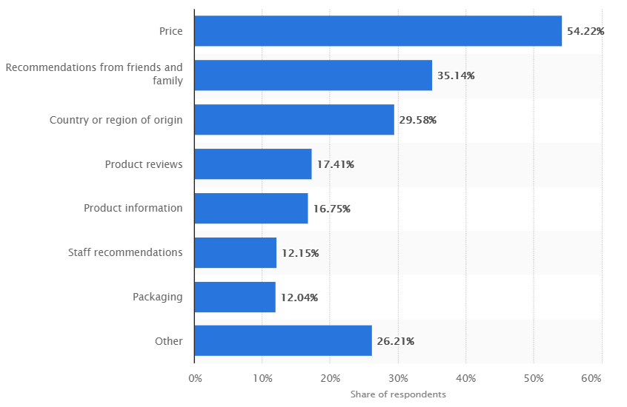
How we decide what to drink?
Canadian purchase criteria when buying wine 2019
Source: Statista. Wine market in Canada

Slide 6
But what about quality?
Let’s consider hypotheses that can help us understand the quality of wine

Slide 7
Data description

Slide 8
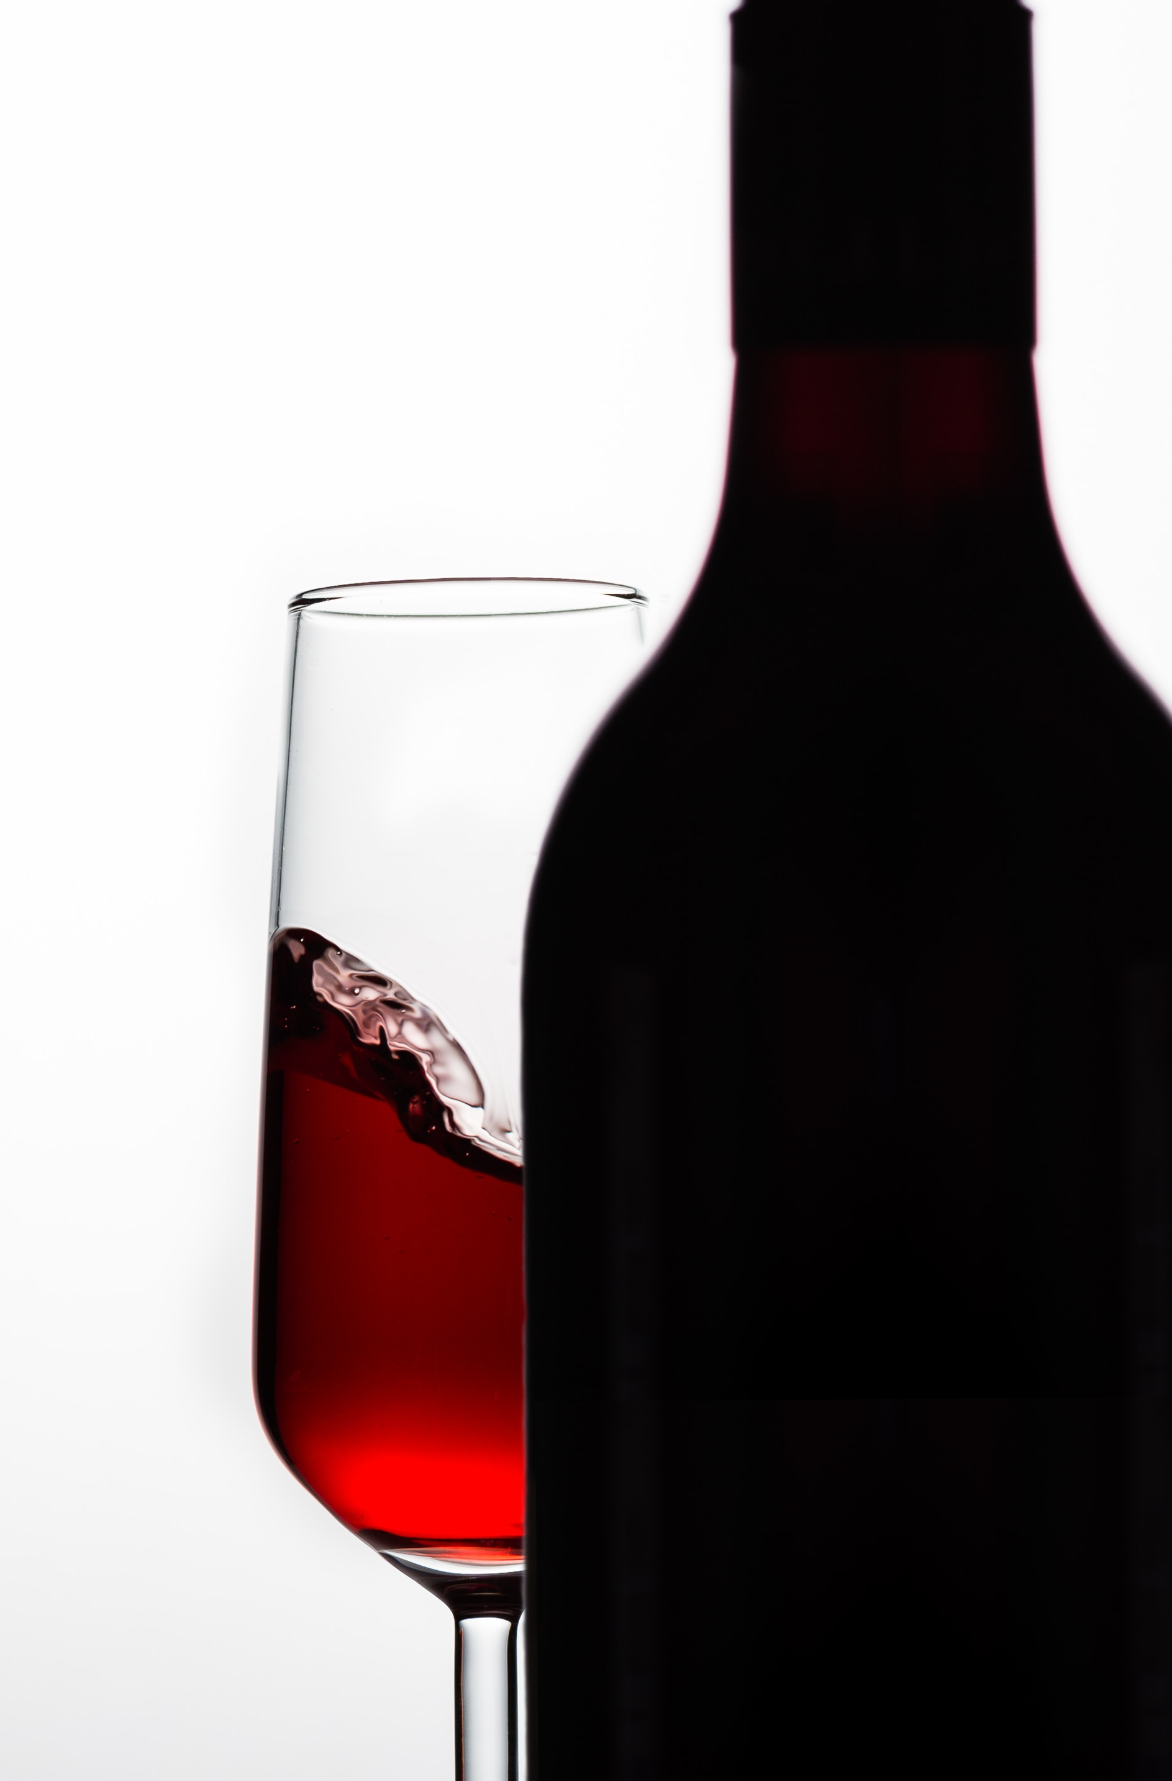
Data description
Records
White: 4,898
Red: 1,599
Data types
Real, integer & string
12 attributes, incl. quality ranking
No missing values
Acids
Fixed, Volatile - high levels can lead to a vinegar taste
Citric acid - in small quantities adds freshness and flavor
Sulfur
Free SO2, Sulphates & Total SO2 – antioxidant and antimicrobial
Alcohol
Ethanol % by volume
Residual sugar: amount of sugar remaining after fermentation
Chlorides: sodium chloride
Density: will differ from water (1) depending on the alcohol and sugar content
pH: 0 (very acidic) to 14 (very basic); most wines are between 3-4 on the pH scale
Quality: score between 0 and 10 (rated by sommeliers)
Source of data: https://archive.ics.uci.edu/ml/datasets/Wine+Quality

Slide 9
Hypothesis testing

Slide 10


Balanced scorecard slide 5
Hypothesis Testing
Hypothesis 3
Hypothesis 1
Hypothesis 2
Mean quality scores for red and white wines are the same
Red and white wines have the same average alcohol levels
Quality is the same for wines with higher and lower than average abv%
Null hypothesis
Alternative hypothesis
Mean quality scores for red and white wines are different
There is difference in alcohol levels between red and white wines
Wines with higher ABV% are of significantly better quality than wines with lower ABV%
mean quality wine is higher for white wine than it is for red wine
mean alcohol level is higher for white wine than it is for red wine
wines with higher alcohol content are preferred
Outcome
The region is known for its white wines (86%) and is the main source of a unique style of white wine. Portugal has the advantage of numerous indigenous grape varieties that are able to keep their acidity in hot climates and including these in a blend provides balancing freshness for rich white wines.
Given the climate in the North-West corner of Portugal, the grape varieties that grow in that region make wines with high ABV%.
Alcohol content of wine has spiked considerably in recent years. Demand is high for intense flavors and higher alcohol content.
Explanation
TOTALS

Slide 11
Logistic Regression

Slide 12
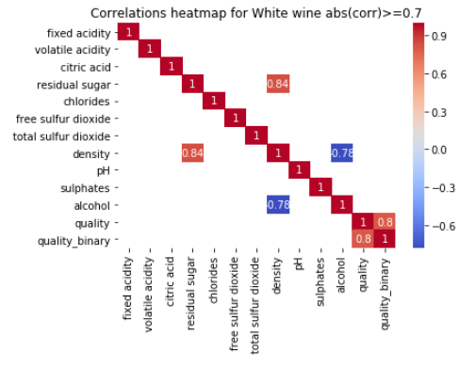
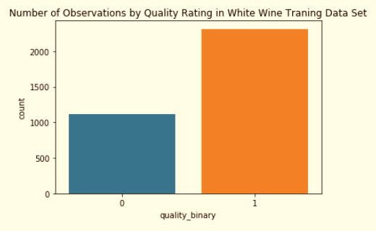
Binary Logistic Regression Model White Wine
2. Checking Logistic Regression Conditions:
Observations are independent of each other (given number of samples, assumed to be reasonable)
There should be little or no multicollinearity among predictors, removed “Density”
3. Log transformed chlorides, free sulfur dioxide, and residual sugar and split data between Train and Test (ratio=0.3).
1. Reclassified wine quality based on their quality score into a binary class:
Quality score
1-10
Premium Wine
>=6
1
Economy Wine
<=5
0
Results: more balance data.
Number of positive and negative responses are comparable
Number of Observations by Quality Rating in White Wine Training Data Set

Slide 13
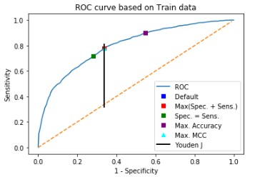
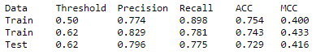
Binary Logistic Regression Model White Wine
Removed statistically insignificant predictors (citric acid and chlorides) after first iteration w/o much change to overall performance.
The wine maker must balance risk of :
FP (predicted as premium but is economy) to avoid disappointing customers and loss of brand equity (higher precision)
FN (predicted as economy but is premium) to minimize loss of revenue/profit, may lead to higher volume/customers in the segment (higher recall).
Tune threshold value.
Based on ROC curve, point of Max MCC was deemed to be optimum, with a threshold value of 0.62 replacing default value of 0.5 in the final model.
Model performance with tune threshold value and Test data was “acceptable”

Slide 14
Linear Regression, SVM

Slide 15
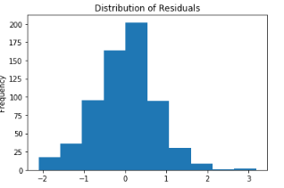
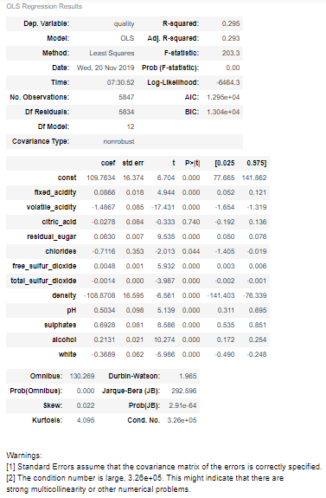
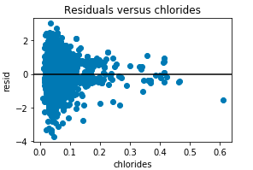
Linear Regression
Independent variables: 1) fixed acidity
2) volatile acidity
3) citric acid
4) residual sugar
5) chlorides
6) free sulfur dioxide
7) total sulfur dioxide
8) density
9) pH
10) sulphates
11) alcohol
Dependant Variable:
Wine quality grouped as continuous scalar variable.
Highlights:
90 / 10 – test train split
Overall score 0.3 R² on test
Observations:
weak Linearity amongst response and independent variables.
Independence of samples assumed as dataset is small.
3. Residuals is normal
4. No constant variability in residuals plot.

Slide 16
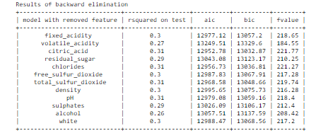
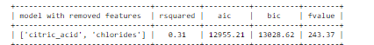
Model improvements
Fine Tuning by backward elimination & p-value
Models have R² ranging from 0.26 to 0.3 which is not better than the first model.
Methods | Ridge Regression | Normalization by Log transformation | SVR with Normalized data
 | Used Regularization that constrains the magnitude of coefficients to reduce model complexity | Free_sulfur_dioxide variable was transformed using np.sqrt. Chlorides, volatile_acidity and sulphates variables are log-transformed | Grid Search Cross Validation to find optimal SVM Params: Kernel, C, Gamma Data Normalization using Standard-Scaler
Outcome | Model coefficients are shrunk towards 0 | Statistically significant coefficients as almost all of the coefficients have p-value<0.05 p-values of citric_acid and chlorides are much better. | -
R² on Test | 0.31 | 0.33 | 0.45

Slide 17
Conclusions

Slide 18
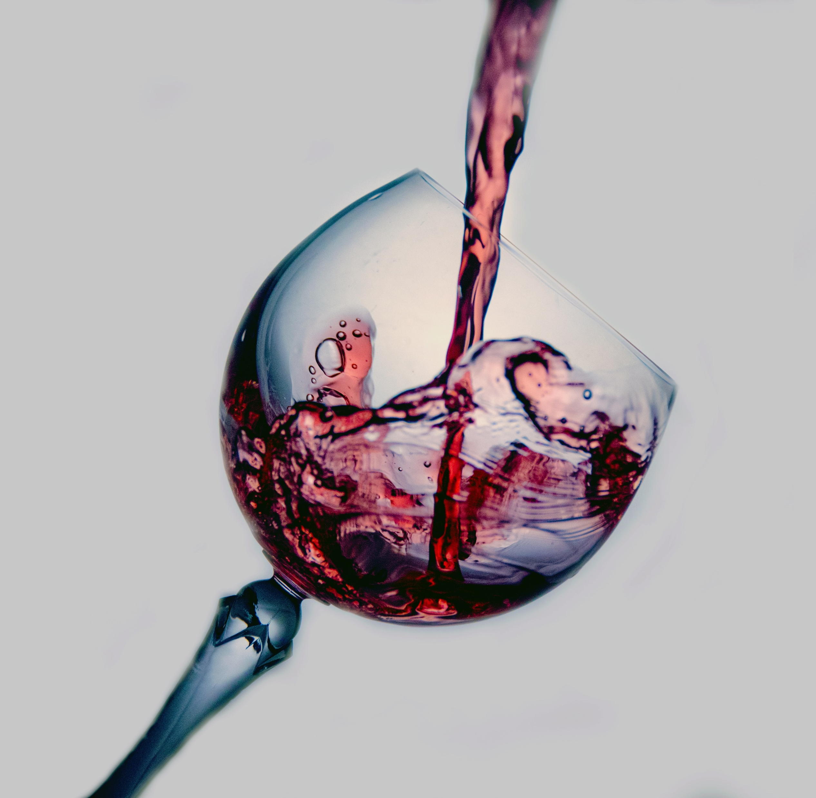
Alcohol content ∝ Quality
Residual sugar ∝ 1 / (alcohol content)
White wine has more sugar
Ingredients that CAN spoil YOUR experience:
Volatile Acid - turns to Vinegar
SO2 - rotten egg like smell

Slide 19
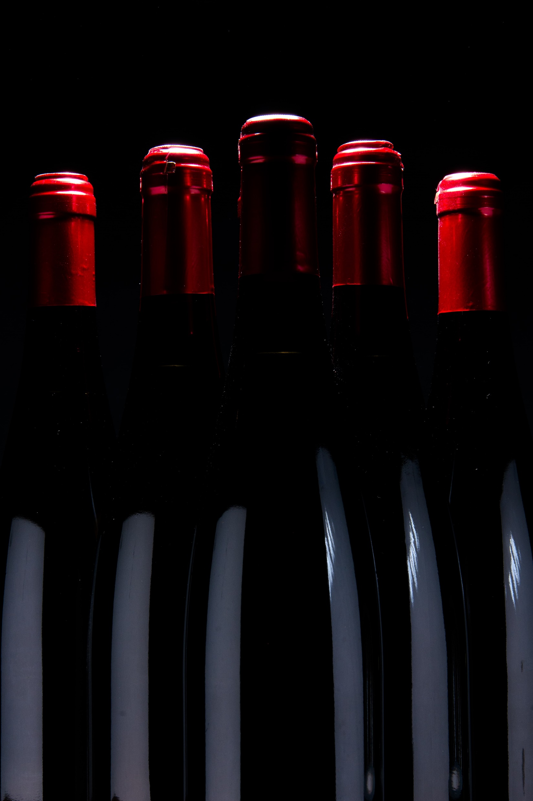
Red or white?

Slide 20
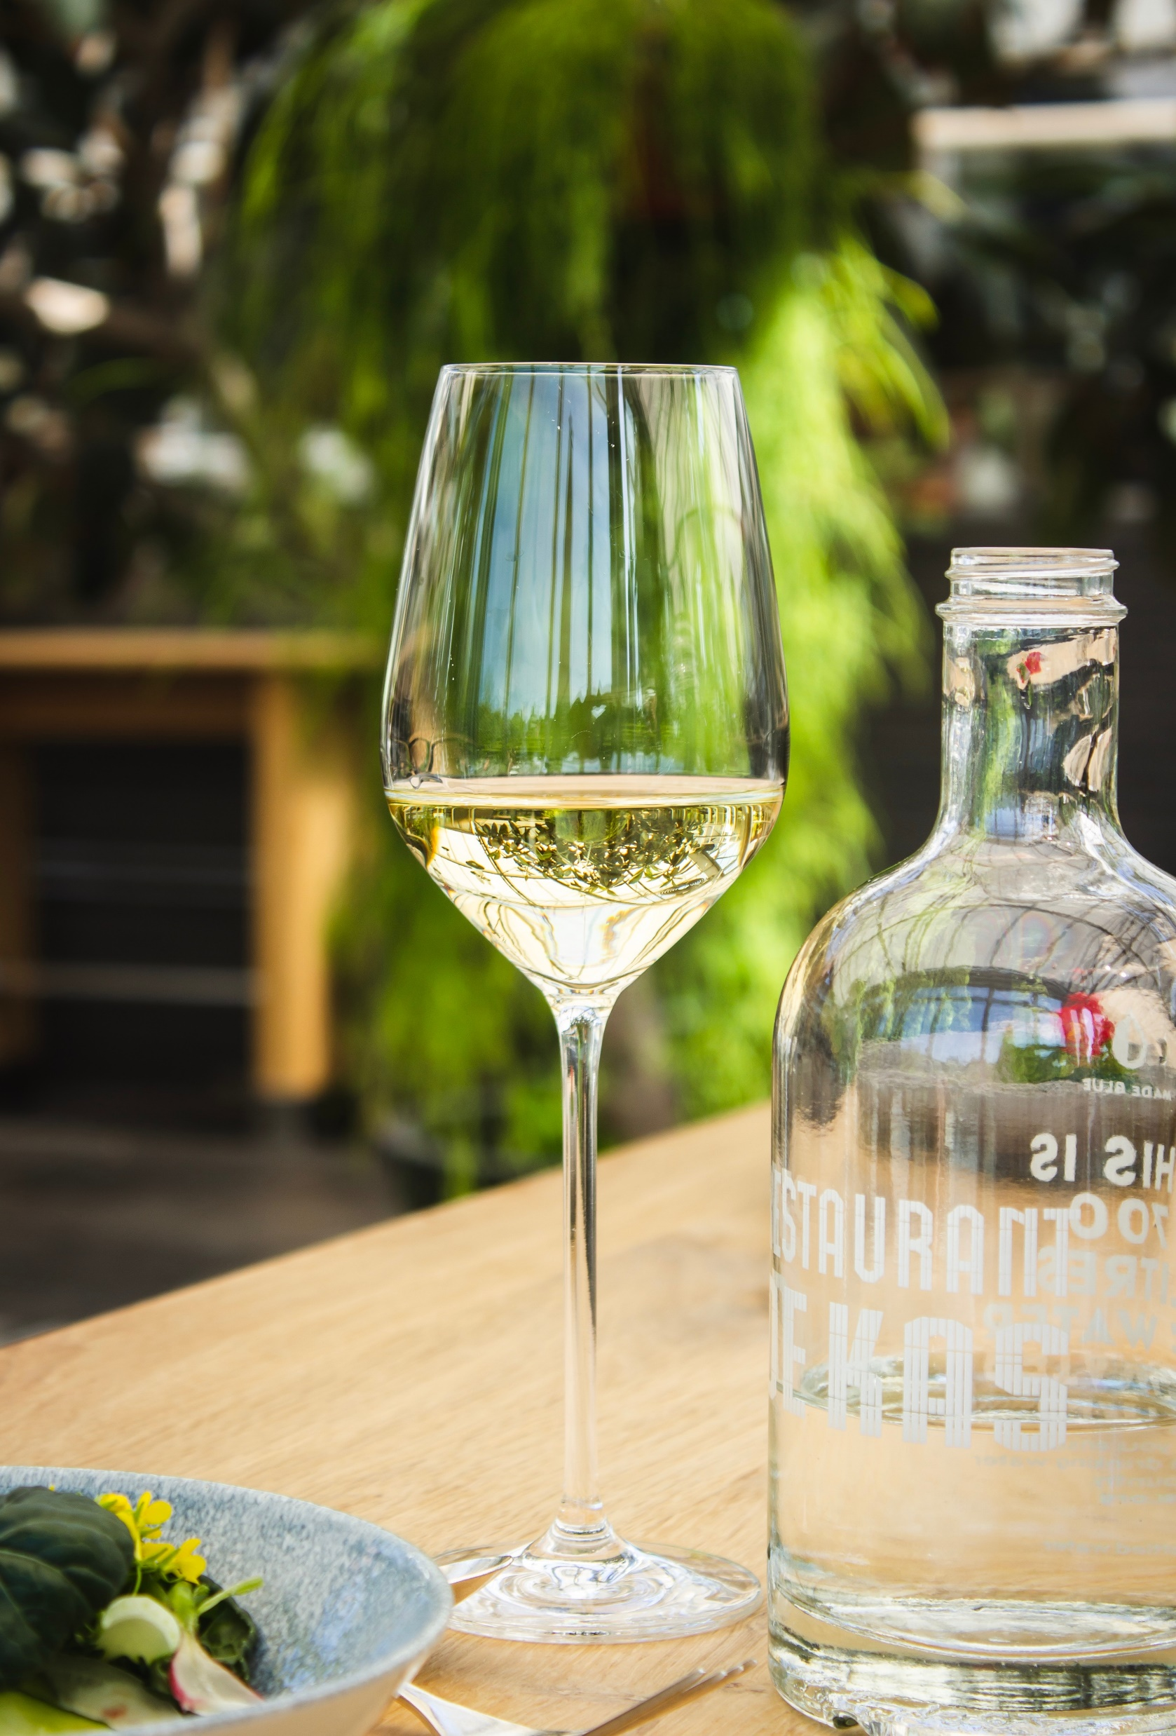
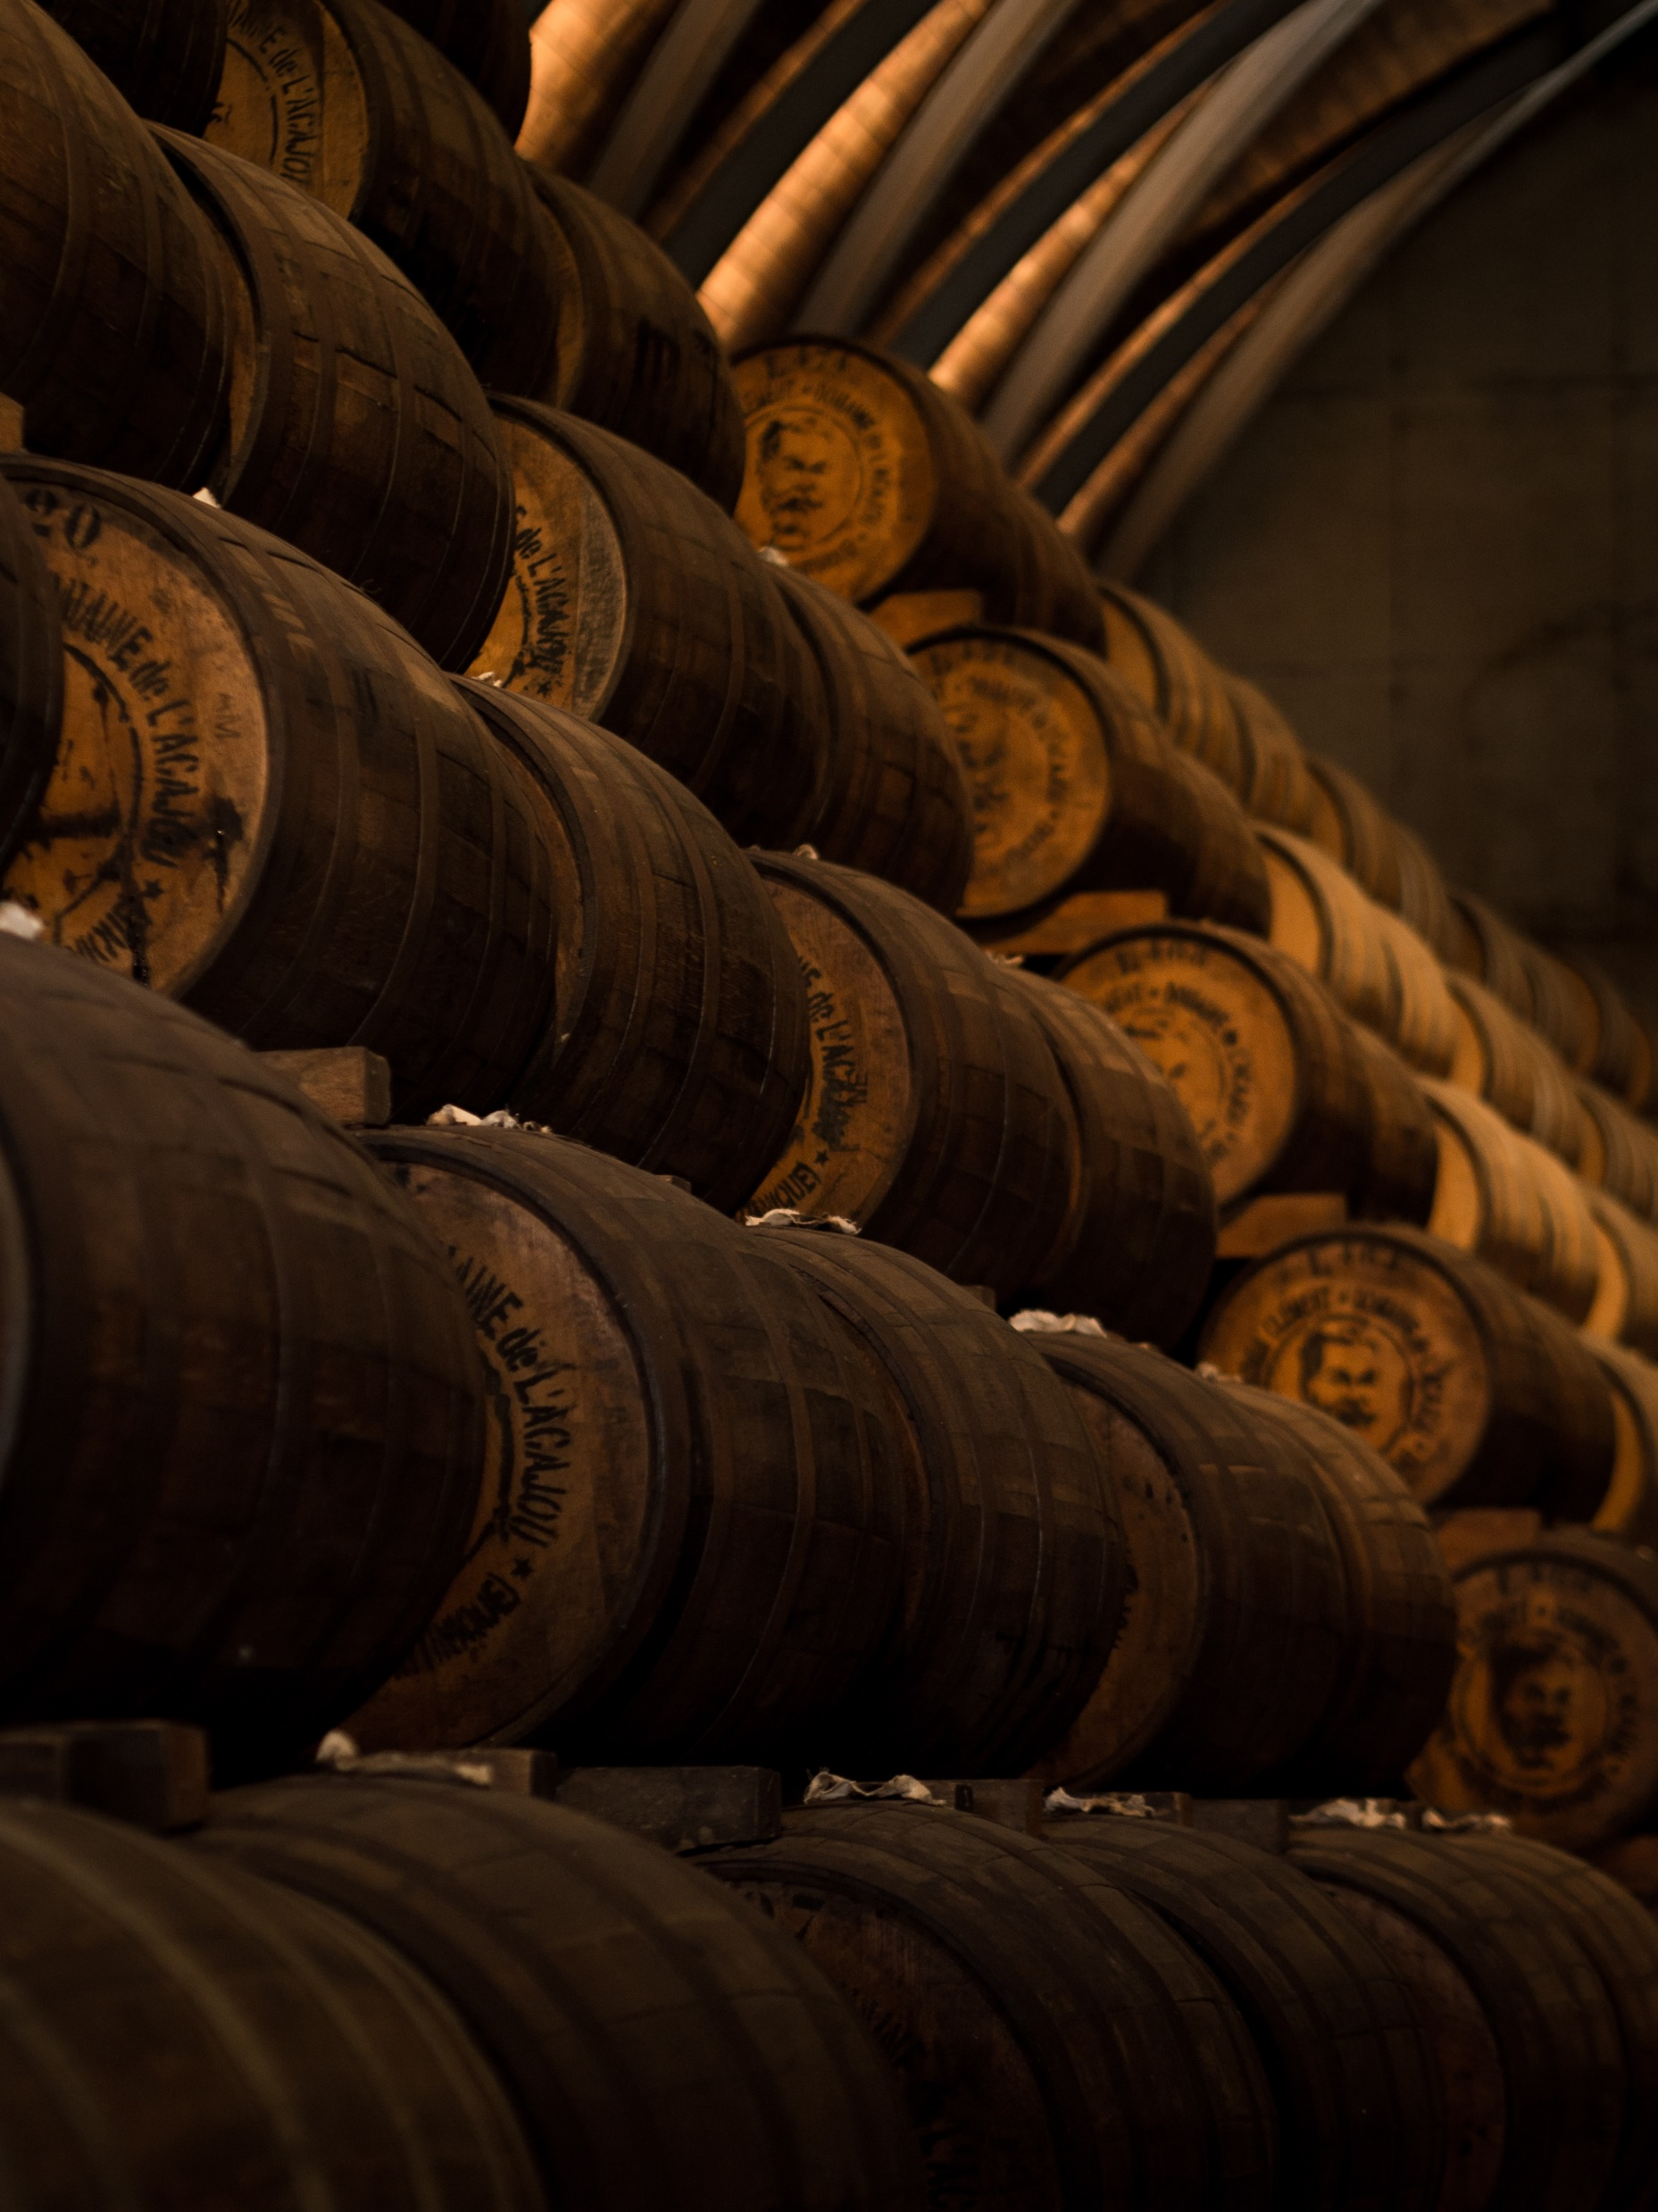
AND THE WINNER IS… (based on dataset used)
Sweet flavor
Floral aroma
Higher alcohol content
Best choice to make:
Portuguese Madeira
Spanish sherry

Slide 21

Thank you
And cheers!

